Slide 1
Compiler Construction
1. Introduction

Slide 2
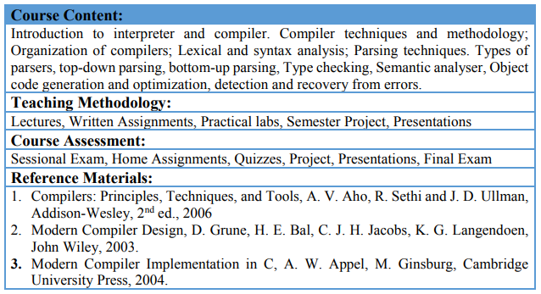
Course Contents

Slide 3
Grading policy
Assignments, Quizzes, Presentations (15 points)
Major Assignment (10 points)
Mid Term (25 points)
Final Term (50 points)

Slide 4
Outline of this lecture
Scope of the course
Disciplines involved in it
Abstract view for a compiler
Front-end and back-end tasks
Modules

Slide 5
Back gourd of Compiler
Software for early computers was primarily written in assembly language. It is usually more productive for a programmer to use a high-level language, and programs written in a high-level language can be reused on different kinds of computers.
Even so, it took a while for compilers to become established, because they generated code that did not perform as well as hand-written assembler, they were daunting development projects in their own right, and the very limited memory capacity of early computers created many technical problems for practical compiler implementations.

Slide 6
From the history of the Compiler
The first practical compiler was written by Corrado Böhm, in 1951, for his PhD thesis. The first implemented compiler was written by Grace Hopper, who also coined the term "compiler", referring to her A-0 system which functioned as a loader or linker, not the modern notion of a compiler. The first Autocode and compiler in the modern sense were developed by Alick Glennie in 1952 at the University of Manchester for the Mark 1 computer. The FORTRAN team led by John W. Backus at IBM introduced the first commercially available compiler, in 1957, which took 18 person-years to create.

Slide 7
Compiler learning
Isn’t it an old discipline?
  Yes, it is a well-established discipline
  Algorithms, methods and techniques are researched and developed in early stages of computer science growth
  There are many compilers around and many tools to generate them automatically
So, why we need to learn it?
  Although you may never write a full compiler, but the techniques we learn is useful in many tasks like
  Anyone who does any software development needs to use a compiler. It is a good idea to understand what is going on inside the tools that you use
  A useful software design technique for large projects is to develop a special-purpose language that makes the project easy to implement
  Compilers benefit tremendously from careful analysis of a problem, and from tools for performing that analysis. A study of compiler design gives a good feeling for how a large problem can be broken down and solved in a manner that is not ad-hoc

Slide 8
Modern Compilers
Evolved gradually
SLOC in Hundreds of Thousands or Millions size
e.g. python interpreter is about 1,500,000 SLOC
Include advanced features of errors detection and recovery suggestion
Constructed by teams of experts in many years

Slide 9
Terminology
Compiler:
  a program that translates an executable program in one language into an executable program in another language
  we expect the program produced by the compiler to be better, in some way, than the original
Interpreter:
  a program that reads an executable program and produces the results of running that program
  usually, this involves executing the source program in some fashion
Our course is mainly about compilers but many of the same issues arise in interpreters

Slide 10
Disciplines involved
Algorithms
Languages and machines (Automata)
Operating systems
Computer architectures

Slide 11
Abstract view
Source
code
Compiler
Machine
code
errors
Recognizes legal (and illegal) programs
Generate correct code
Manage storage of all variables and code
Agreement on format for object (or assembly) code

Slide 12
Compiler Phases
Lexical analysis (Scanning)
Syntax Analysis (Parsing)
Syntax Directed Translation
Intermediate Code Generation
Machine independent Code Optimization
Code Generation
Machine Dependent Code Optimization

Slide 13
Front-end, Back-end division
Source
code
Front end
IR
Back end
Machine
code
errors
Also called Analysis and Synthesis parts
Front end maps legal code into IR
Back end maps IR onto target machine
Simplify retargeting
Allows multiple front ends
Multiple passes -> better code

Slide 14
Front end
Source
code
Scanner
tokens
Parser
IR
errors
Recognize legal code
Report errors
Produce IR
Preliminary storage maps

Slide 15
Front end
Source
code
Scanner
tokens
Parser
IR
errors
Scanner:
  Maps characters into tokens – the basic unit of syntax
    x = x + y becomes <id, x> = <id, x> + <id, y>
  Typical tokens: number, id, +, -, *, /, do, end
  Eliminate white space (tabs, blanks, comments)
A key issue is speed so instead of using a tool like LEX it sometimes needed to write your own scanner

Slide 16
Front end
Source
code
Scanner
tokens
Parser
IR
errors
Parser:
  Recognize context-free syntax
  Guide context-sensitive analysis
  Construct IR
  Produce meaningful error messages
  Attempt error correction
There are parser generators like YACC which automates much of the work

Slide 17
Front end
Context free grammars are used to represent programming language syntaxes:
<expr> ::= <expr> <op> <term> | <term>
<term> ::= <number> | <id>
<op> ::= + | -

Slide 18
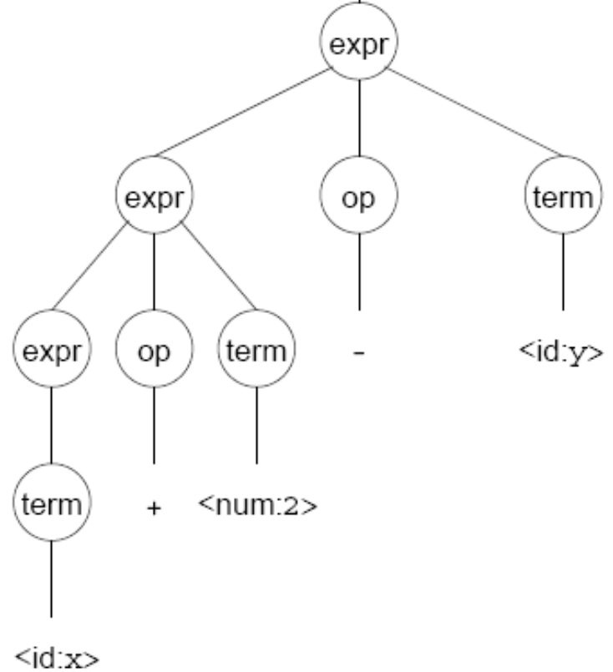
Front end
A parser tries to map a program to the syntactic elements defined in the grammar
A parse can be represented by a tree called a parse or syntax tree

Slide 19
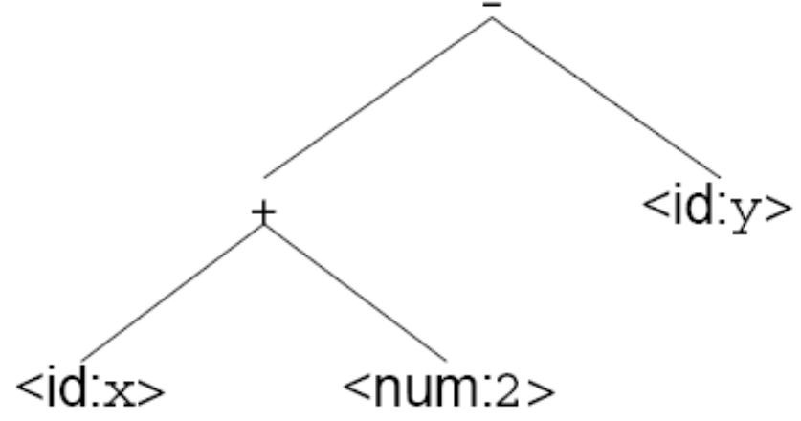
Front end
A parse tree can be represented more compactly referred to as Abstract Syntax Tree (AST)
AST is often used as IR between front end and back end

Slide 20
Back end
Instruction
selection
Register
Allocation
Machine code
IR
errors
Translate IR into target machine code
Choose instructions for each IR operation
Decide what to keep in registers at each point
Ensure conformance with system interfaces

Slide 21
Back end
Instruction
selection
Register
Allocation
Machine code
IR
errors
Produce compact fast code
Use available addressing modes

Slide 22
Back end
Instruction
selection
Register
Allocation
Machine code
IR
errors
Have a value in a register when used
Limited resources
Optimal allocation is difficult

Slide 23
Traditional three pass compiler
Source
code
Front end
IR
Middle
end
IR
Back end
Machine
code
errors
Code improvement analyzes and change IR
Goal is to reduce runtime

Slide 24
Middle end (optimizer)
Modern optimizers are usually built as a set of passes
Typical passes
  Constant propagation
  Common sub-expression elimination
  Redundant store elimination
  Dead code elimination

Slide 25
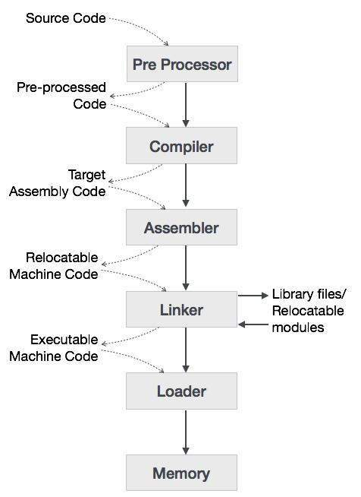
Language Processing System
(Cousins of Compilers)

Slide 26
Key Points
  Machine and Assembly Languages.
  Machine languages were the first generation programming languages, followed by assembly languages.
  Programming in these languages was time consuming and error prone.

Slide 27
Key Points
  Modeling in Compiler Design.
  Compiler design is one of the places where theory has had the most impact on practice.
  Models that have been found useful include automata, grammars, regular expressions, trees, and many others.

Slide 28
Key Points
Code Optimization
  Although code cannot truly be “optimized,“
  The science of improving the efficiency of code is both complex and very important
  It is a major portion of the study of compilation.

Slide 29
Key Points
Higher-Level Languages
  As time goes on, programming languages take on progressively more of the tasks that formerly were left to the programmer, such as memory management, type-consistency checking, or parallel execution of code.

Slide 30
Key Points
Compilers and Computer Architecture.
  Compiler technology influences computer architecture, as well as being influenced by the advances in architecture.
  Many modern innovations in architecture depend on compilers being able to extract from source programs the opportunities to use the hardware capabilities effectively.

Slide 31
Key Points
Software Productivity and Software Security
  The same technology that allows compilers to optimize code can be used for a variety of program analysis tasks, ranging from detecting common program bugs to discovering that a program is vulnerable to one of the many kinds of intrusions that “hackers" have discovered.

Slide 32
Further Readings
Chapter 1 of the book
  (Compilers Principles, Techniques, & Tools)
  By Alfred V. Aho
  Second Edition

